Slide 1


2026 International Conference for Convergence in Computing Technology (I3CTCON) Venue: - Rhythm Lonavala: An All-Suite Resort , Lonavala, Maharashtra.
“A Hybrid Approach for Predictive Waste Classification and Resource Optimization using Deep Transfer Learning and Reinforcement Learning”
Paper ID: 2286
Presenter & Co-Author: Navadeep Jakkamsetti
Affiliation: Vel Tech Rangarajan Dr. Sagunthala R&D Institute of Science and Technology (Deemed to be University established under Section 3 of the UGC Act, 1956), Avadi, Chennai, Tamil Nadu, India

Slide 2
INDEX
S.No. | Contents
1 | Problem Statement
2 | Proposed Solution
3 | Methodology
4 | Implementation
5 | Results
6 | Future Work
7 | Q&A Session

Slide 3
Problem Statement
Rapid urbanization and industrial growth have led to massive increases in solid waste generation. Traditional waste management systems rely on manual sorting and static routing, leading to:
Low recycling efficiency
High landfill overflow
Loss of reusable resources
Increased carbon emissions
Existing AI solutions:
Focus only on waste classification OR
Focus only on resource allocation

Slide 4
Proposed Solution
We developed an integrated AI-driven system consisting of:
Waste Classification Module
Uses ResNet50 model that classifies waste into plastic, paper, metal, glass, organic
Categorizes the classified waste images into separate waste categories.
Fine-tunes on domain specific waste dataset for better accuracy.
Resource Optimization Module
Uses Proximal Policy Optimization (PPO) agent that learns optimal routing decisions, bin allocation, resource optimization.
Randomly generated dataset is used by considering factors like recycling facility capacity (per day), human labor for sorting/processing, number of bins, number of trucks, and truck routes for landfill or incineration.
Maximizes recycling reward & minimizes landfill cost.

Slide 5
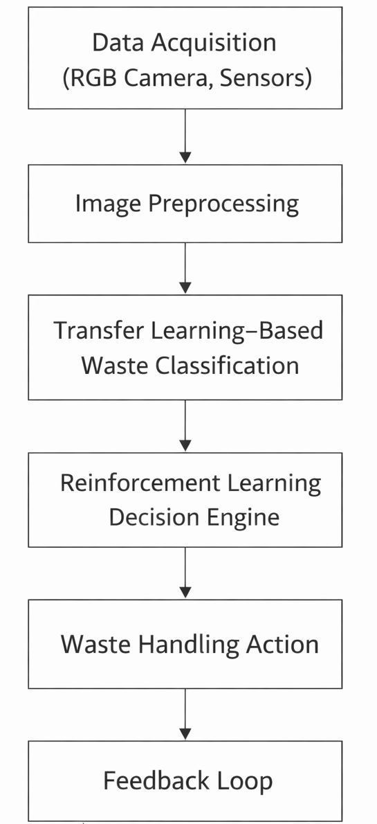
Methodology
The proposed system consists of four major stages:
Data Acquisition
RGB camera, dataset images or sensor inputs
The images are resized to 224×224 for normalization and preprocessing
Transfer Learning Classification
Uses ResNet50 pre-trained for classification
Fine‑tuned on waste dataset
Reinforcement Learning Decision Engine
Environment modeled as Markov Decision Process (MDP)
PPO agent optimizes routing and resource allocation
Waste Handling & Feedback
Continuous feedback loop for system improvement
Evaluation & Deployment
System is deployed as a web application using FastAPI
Frontend sends waste images to backend APIs
Backend processes classification and optimization results and returns them to the interface.

Slide 6
Implementation
Development Environment:
Google Colab (Model Training & Experimentation)
VS Code (Local Integration & Testing)
GitHub (Version Control & Repository Management)
Frameworks & Libraries Used:
TensorFlow / Keras
ResNet50
OpenCV (Image preprocessing)
Gymnasium (RL Environment Simulation)
Stable-Baselines3 (Implementation of PPO agent)
NumPy (State representation)
Matplotlib (Reward visualization)
Deployment & Integration:
FastAPI (Backend & Integration)
HTML,CSS,JS (Frontend UI components)
Render (Deployment)

Slide 7
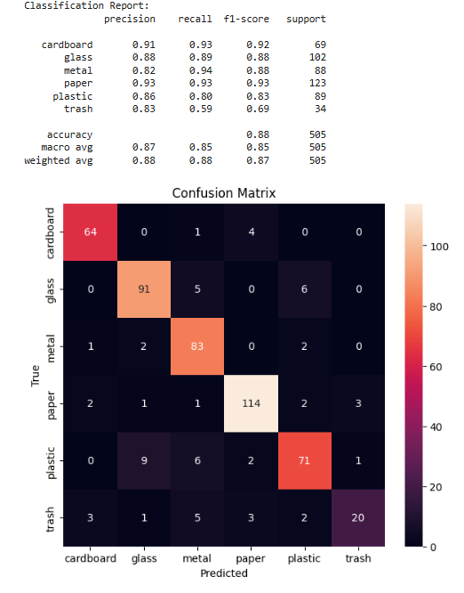
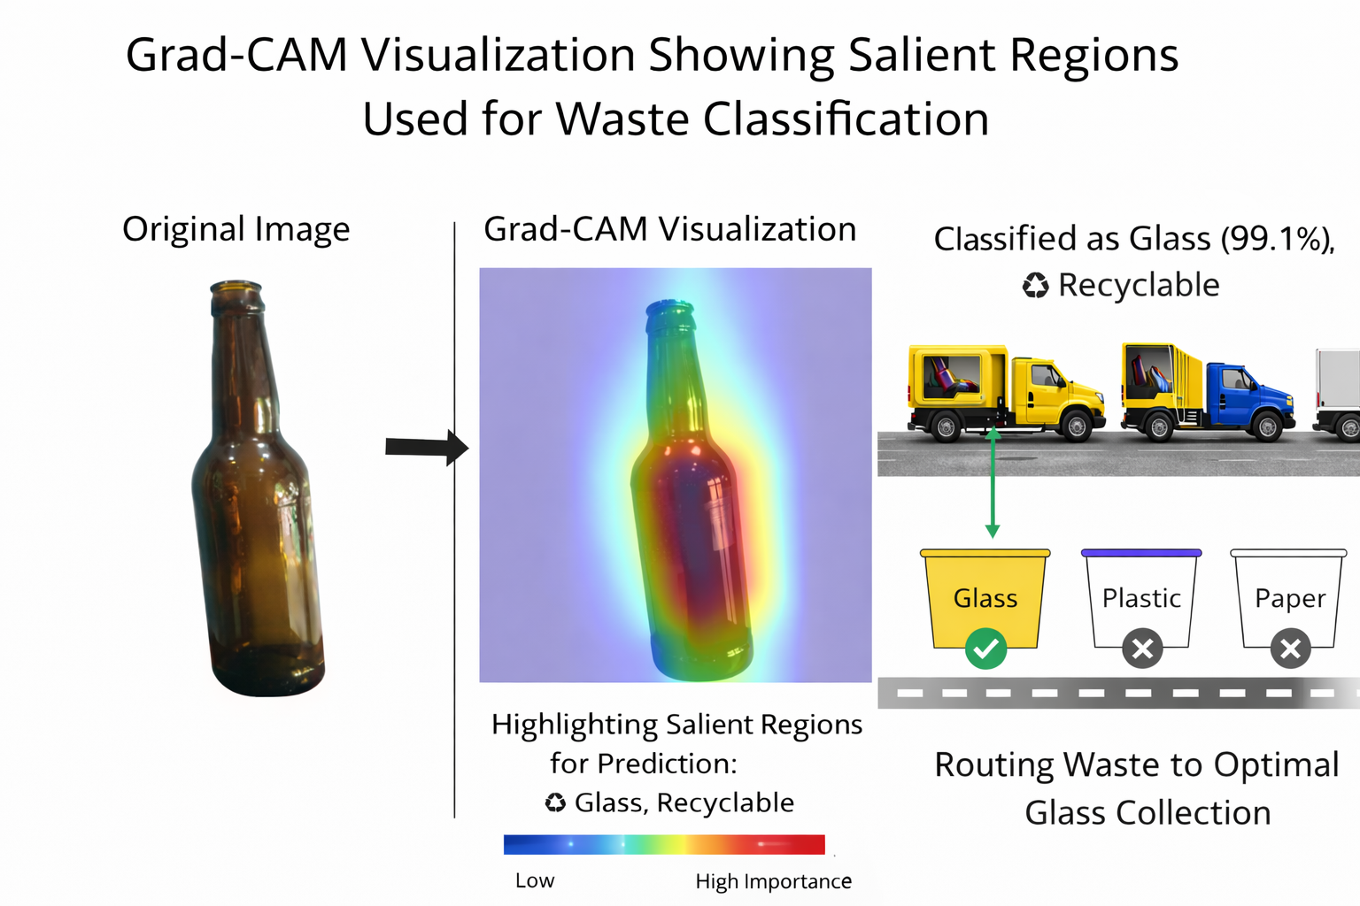
Results

Slide 8
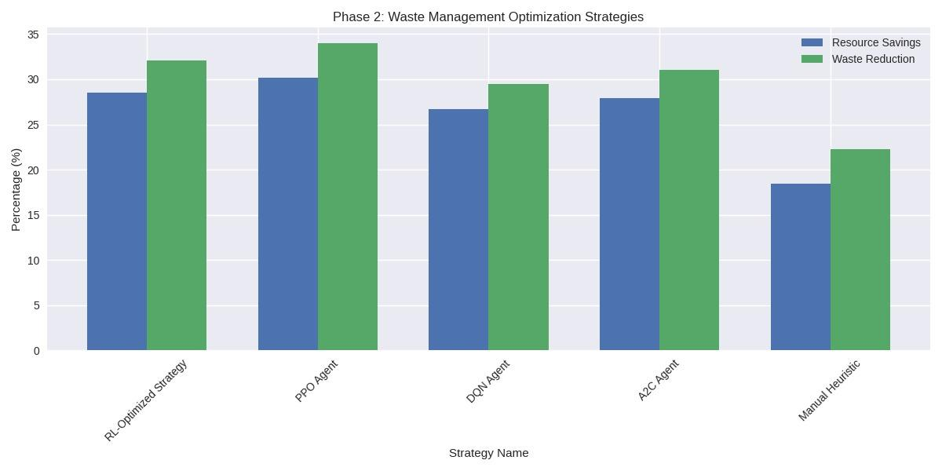
Results
Reinforcement Learning (PPO) Results
Mean Training Reward: 15.7
Recycling Rate Improvement: +28%
Landfill Reduction: −18%
Estimated Monthly Cost Reduction: ~$800 (Simulated)

Slide 9
Future Work
Real-Time IoT Integration:
Integration with smart bins equipped with Embedded cameras, weight sensors and camera sensors.
Multi-Agent Reinforcement Learning (MARL):
Extend single RL agent to multi-agent coordination.
Optimize multiple waste collection vehicles.
Real-World Dataset Expansion:
Collect region-specific waste images.
Address mixed-material waste challenges.
Carbon Footprint & Sustainability Metrics:
Integrate carbon emission tracking.
Evaluate long-term environmental impact.

Slide 10
Q&A Session
Why did you choose ResNet50 over other CNN models?
ResNet50 provides deeper representation learning with residual connections while maintaining manageable computational complexity.
Why did you use PPO/DQN for optimization?
Waste routing is a sequential decision-making problem. PPO offers stable training. DQN is suitable for discrete action spaces.
How is your work different from existing waste classification systems?
Most works focus only on classification. Some focus only on routing optimization. Our contribution is an integrated framework combining Deep Learning and Reinforcement Learning.
What are the limitations of your system?
The primary limitation is dataset generalization and simulation-based evaluation.

Slide 11
THANK YOU

